Slide 1
Connection Pooling in Java

Slide 2
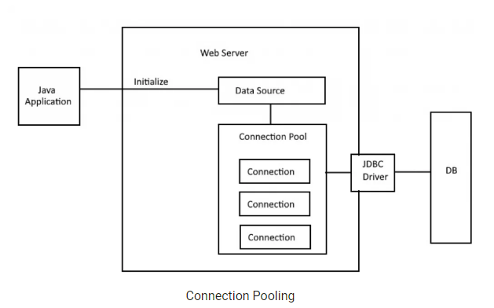

Slide 3
Three Tasks of a Connection Pooling Framework
Any connection pooling framework needs to do three tasks:
Creating Connection Objects
Manage usage of created Objects and validate them
Release/Destroy Objects

Slide 4
Connection Pooling in Java Application
Apache Commons DBCP 2
HikariCP
C3P0

Slide 5
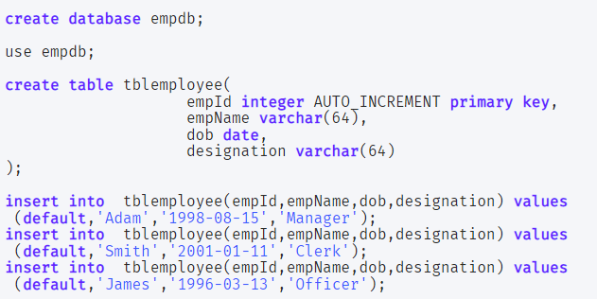
Database Scripts

Slide 6


Connection Pooling in Java

Slide 7
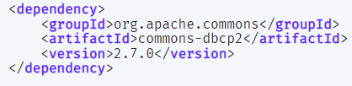
Apache Commons DBCP 2

Slide 8
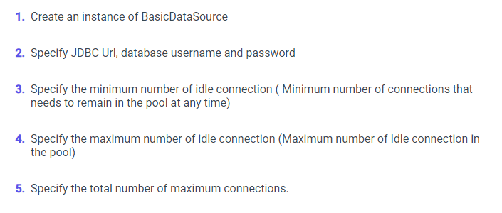
Apache Commons DBCP 2
BasicDataSource:
As the name suggests, it is simple and suitable for most common use cases. It internally creates a PoolingDataSource.

Slide 9
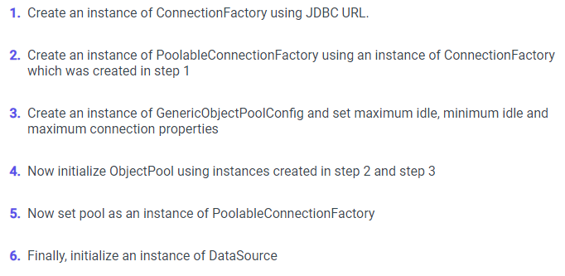
Apache Commons DBCP 2
PoolingDataSource:
It offers more flexibility. You only need to change code which creates DataSource. The rest of the code will remain the same.

Slide 10
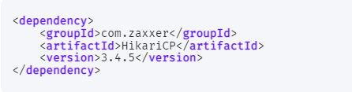
HikariCP

Slide 11
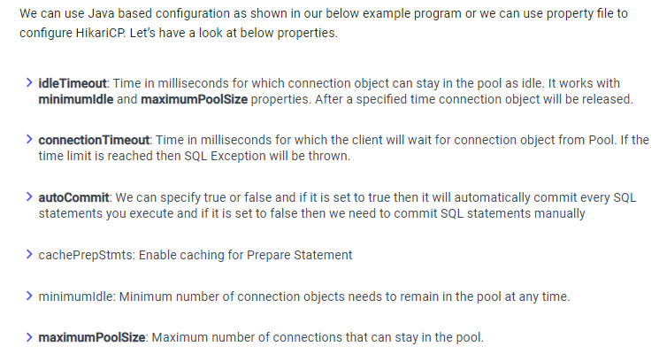
HikariCP Configuration

Slide 12

C3PO

Slide 13
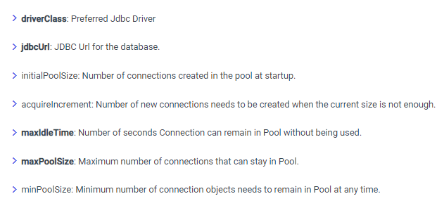
C3PO Configuration

